Slide 1

Comprehensive Analysis of Aircraft Wildlife Strikes
Trends, Risks, and Mitigation Insights
Data-Driven Evaluation of Safety, Operational Efficiency, and Cost Impacts
Prepared using Bird Strike Dataset (FAA Wildlife Strike Database) | By Mukesh V October 2025

Slide 2
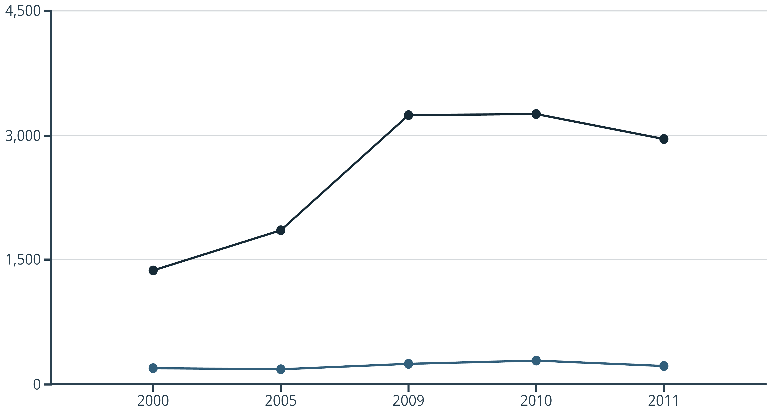
CHAPTER 1: SAFETY IMPROVEMENT
Yearly Trend of Bird Strikes and Damage Frequency (2000–2011)
Total Strikes
Damaging Strikes
Total reported strikes rose sharply through 2000–2010, suggesting increased reporting or flight density. Crucially, damaging strikes remained a small share,
indicating that safety measures (aircraft design, procedures) are effective at limiting impact severity.
The increase in total strikes is attributed to higher air traffic volume and improved reporting accuracy, while stable damage rates show effective safety enforcement and design improvements.

Slide 3
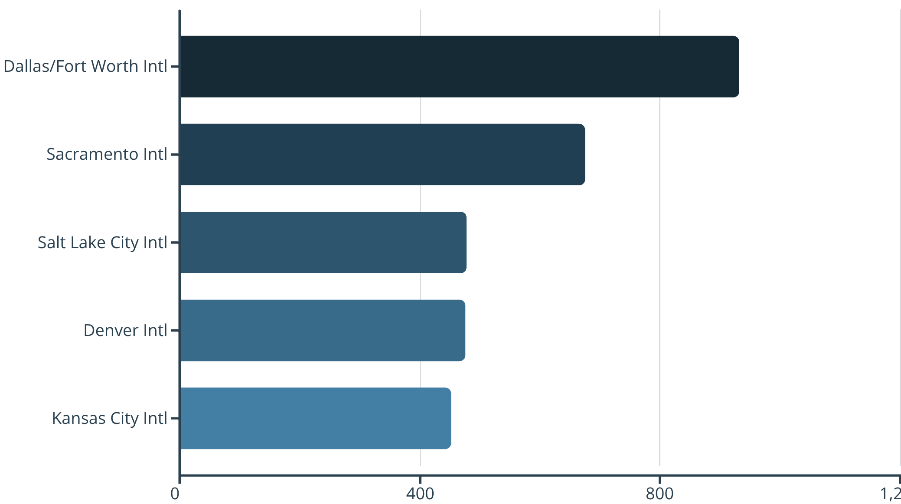
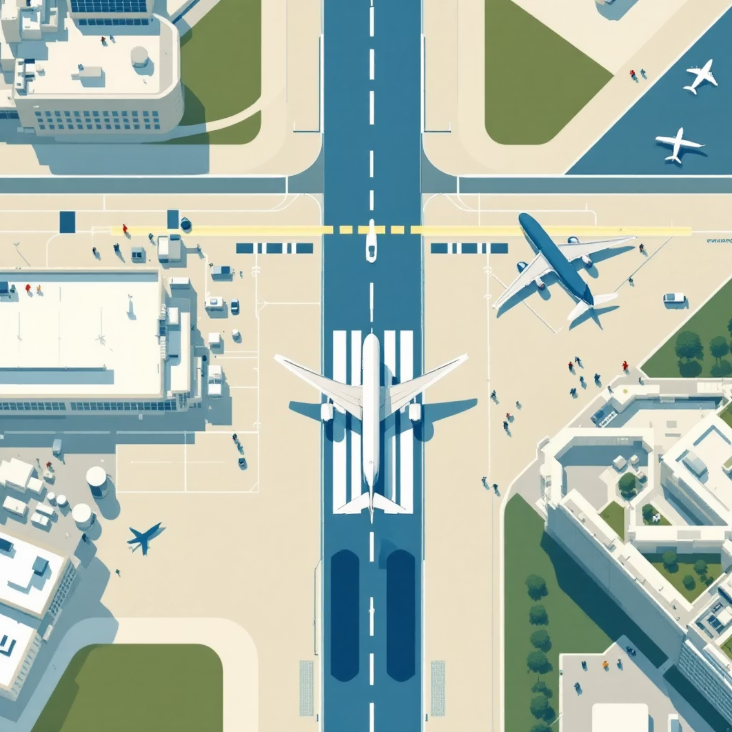
CHAPTER 2: REGULATORY COMPLIANCE
Airports with Highest Recorded Bird Strikes
A few major airports account for the bulk of reports. This suggests strong reporting compliance but also highlights potential local bird-activity hotspots that require targeted mitigation efforts.
High strike counts are often a result of large flight volume combined with advanced wildlife monitoring and reporting systems, leading to more documented incidents.

Slide 4




CHAPTER 3: INJURY & WILDLIFE PREVENTION
Top Bird Species Involved in Damaging Strikes
Unknown Bird - Medium/Large
Canada Goose
511 medium and 286 large unknown bird strikes. The dominance of "Unknown bird" highlights critical data collection gaps, limiting targeted mitigation effectiveness.
210 damaging strikes. Large-bodied species like geese contribute most significantly to severe impacts due to their mass.
Red-tailed Hawk
Turkey Vulture
108 damaging strikes. These predatory birds often hunt near airport perimeters, increasing risk.
95 damaging strikes. Vultures are large and often fly at higher altitudes, posing a significant threat.
Bigger birds cause more severe impacts upon collision. Improving species identification protocols is essential for converting "Unknown bird" reports into actionable intelligence for wildlife management.

Slide 5
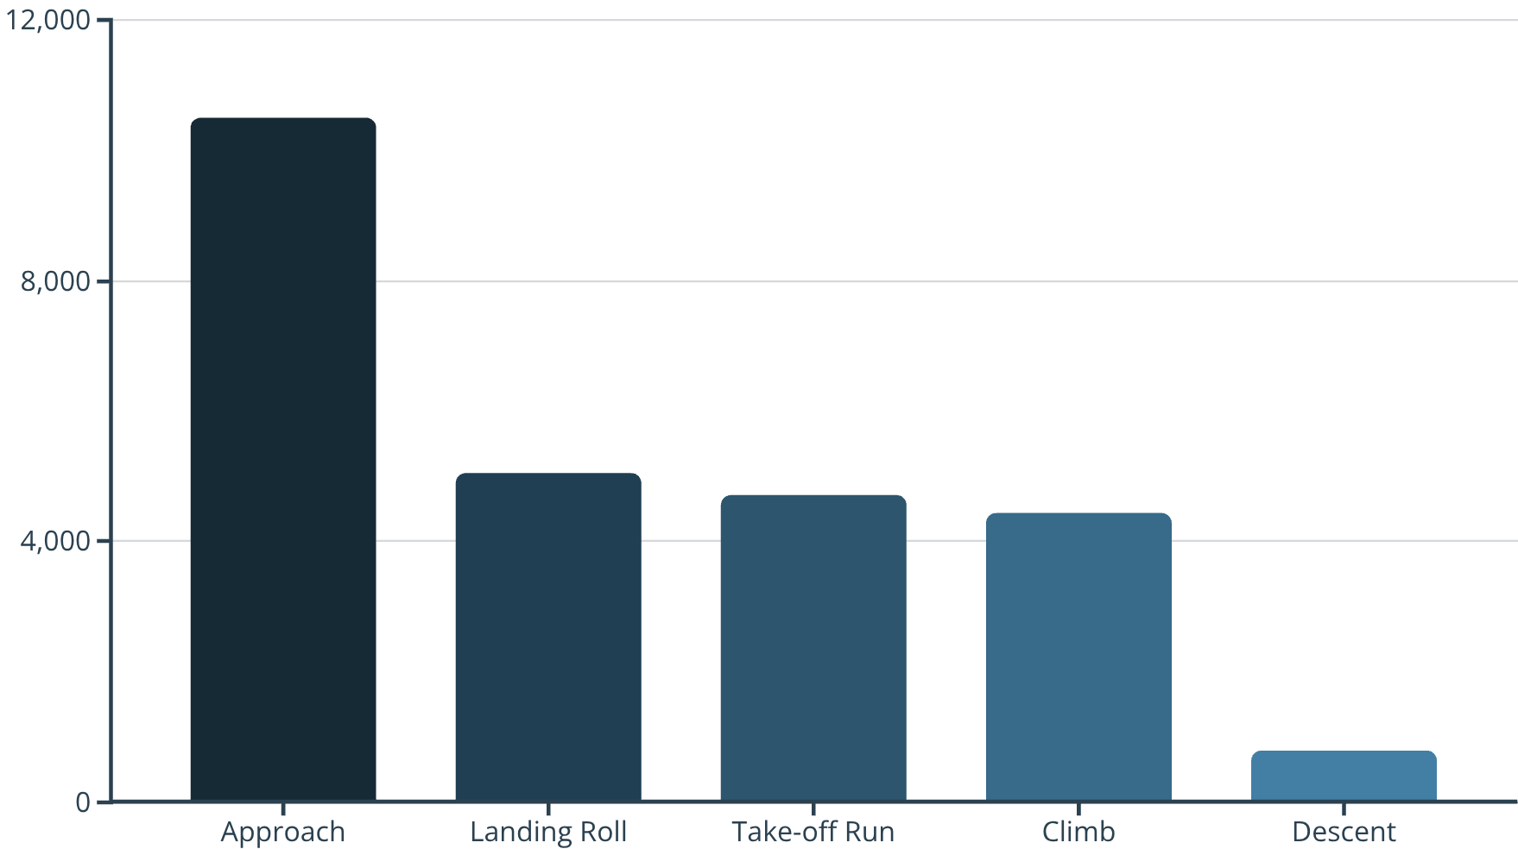

CHAPTER 4: OPERATIONAL EFFICIENCY
Impact of Bird Strikes by Flight Phase
Approach and Landing are High-Risk Phases
The approach and landing phases account for the highest number of incidents, leading to the greatest operational impact, often causing precautionary landings, delays, and schedule disruptions.
Bird activity is concentrated near runways and low-altitude airspace.
Aircraft are most vulnerable due to low altitude and limited maneuver space during these critical phases.

Slide 6
CHAPTER 5: COST REDUCTION
Total Financial Impact by Aircraft Model
A small number of aircraft models account for a large proportion of total repair and operational costs. Targeted safety investments in these specific models can yield major financial savings.
$14.1M
$11.9M
$8.9M
$8.6M
LEARJET-60
B-767-300
B-757-200
B-737-300
Highest total cost, often due to high-value components and complex repairs.
Significant costs associated with wide-body maintenance and downtime.
Older models may incur higher repair costs for replacement parts.
High volume of flights contributes to overall accumulated cost.
The total cost is heavily influenced by the aircraft's repair cost, part value, and the severity of the impact.

Slide 7

CHAPTER 6: RISK MANAGEMENT & COMMUNICATION
Effect of Pilot Warnings on Damage Likelihood
Early Warning Reduces Damage Probability by ~1.8%
Pilot Warned?
Damaging %
When pilots were warned about wildlife activity, the probability of the strike resulting in damage dropped from 9.57% to 7.82%. This measurable benefit highlights the value of active communication systems.
Yes
7.82%
Early warnings allow pilots to adjust flight paths or speed.
No
9.57%
Increases visual awareness during critical flight phases.
Supports the deployment of active bird-radar systems and real-time alerts.

Slide 8
Key Takeaways: Where Risk is Highest
1
Operational Risk
Approach and landing phases are the highest operational risk, accounting for the most incidents and precautionary landings.
2
Damage Severity
Large-bodied and unknown birds (e.g., Canada goose, turkey vulture) contribute disproportionately to damaging events.
3
Mitigation Effectiveness
Pilot warnings significantly reduce the probability of a damaging event (from 9.6% to 7.8%), demonstrating a clear, measurable benefit.
4
Financial Concentration
A small set of aircraft models (e.g., Learjet-60, B-767-300) account for large portions of the total repair cost.
5
Reporting Hotspots
Reporting volume is uneven across airports; hotspots like DFW and Sacramento show much higher recorded counts, indicating either true incidence or better reporting compliance.

Slide 9



Strategic Business Recommendations
To maximize safety and cost reduction, mitigation efforts must be targeted and data-driven.
Prioritize Approach/Departure Corridors
Focus wildlife mitigation efforts (radar, habitat modification, night-time dispersal) in approach and departure corridors for the biggest operational win.
Expand Pilot Warning Systems
Deploy or expand real-time radar alerts and NOTAMs, as these systems are proven to reduce damaging incidents.
Improve Species Identification
Standardize protocols (photo collection, DNA analysis) to convert "Unknown bird" reports into actionable species intelligence for targeted deterrence.

Slide 10


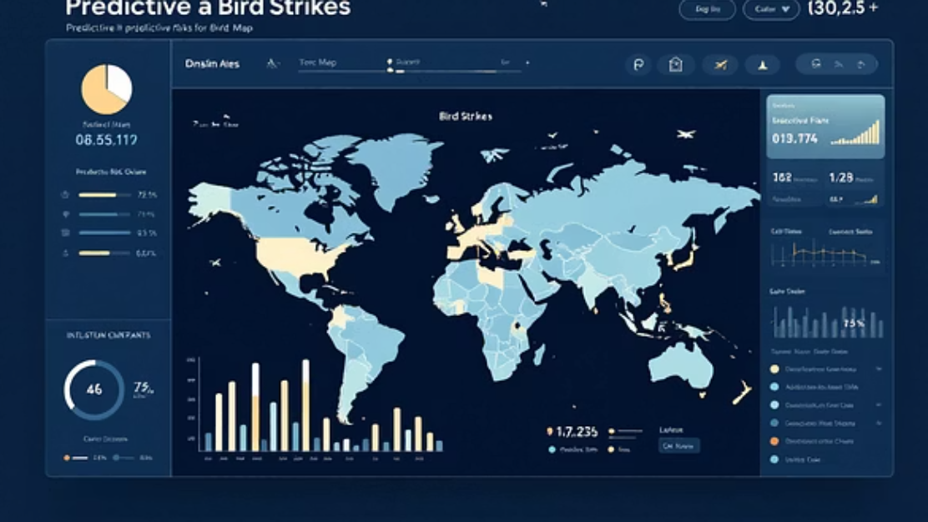
Future-Proofing Risk Management
Targeted Investment
Standardize Reporting
Predictive Modeling
Target preventive investment at high-cost aircraft types (inspections, shields, revised routing) to reduce overall repair spend.
Standardize digital reporting across all airports to close inconsistency gaps and enable centralized, accurate monitoring.
Build predictive models based on seasonality, weather, and migration patterns to schedule deterrence during high-risk windows.

